Slide 1
Data Analytics
Nihat Naghizade (Founder of Shopholic Academy)

Slide 2
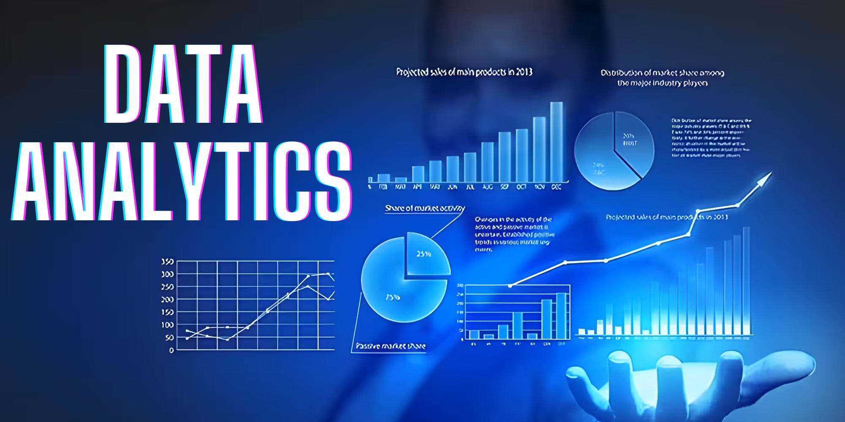
Introduction to Data Analytics
Data Analytics is the process of examining, cleaning, transforming, and interpreting data to extract meaningful insights, identify patterns, and support decision-making. It involves using various techniques, tools, and technologies to analyze data and derive actionable conclusions.

Slide 3
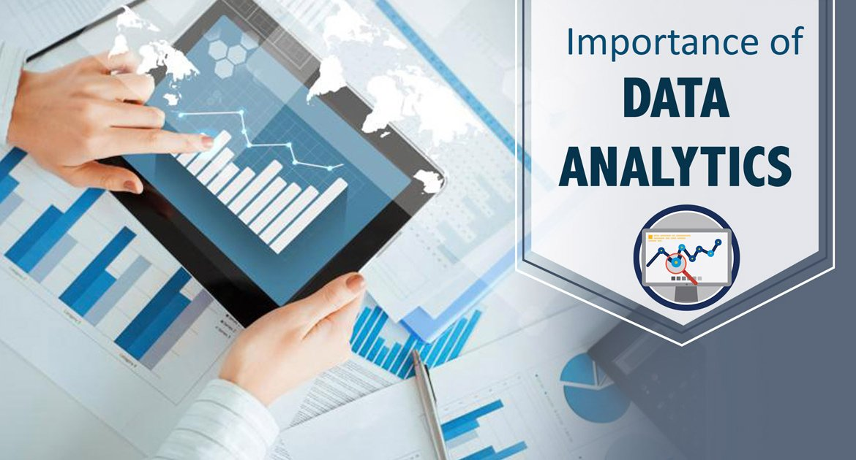
Data analytics plays a crucial role in modern businesses and industries by transforming raw data into valuable insights. It helps organizations make informed decisions, optimize processes, and gain a competitive edge.

Slide 4
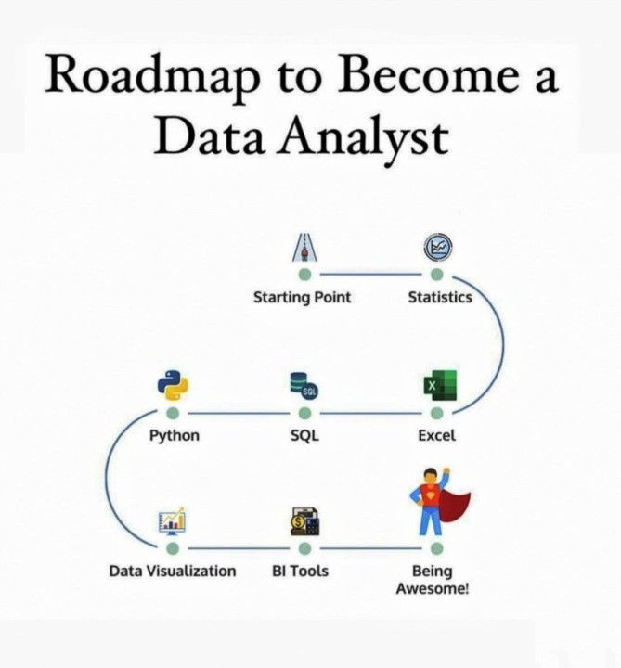

Slide 5
Real-World Examples:
Healthcare: Hospitals analyze patient data to improve diagnosis and treatment plans.
E-commerce: Platforms like Amazon use data analytics to recommend products based on browsing history.
Finance: Banks use analytics to detect fraudulent activities and assess credit risks.

Slide 6
List of Companies Using Data Analysts in Different Fields:
Amazon – Uses predictive analytics for product recommendations and supply chain optimization
Netflix – Uses data analytics for personalized content recommendations.
Alibaba – Uses data analytics for personalized shopping experiences.
Spotify – Analyzes user behavior to create curated playlists.
Walmart – Analyzes customer shopping patterns to improve inventory management.
T-Mobile – Uses machine learning to predict customer churn.
Facebook (Meta) – Analyzes user data for personalized content and ads.
EA Sports – Uses data analytics for player behavior and game optimization.
Microsoft – Utilizes data analytics for product development and customer insights.
NBA & FIFA – Uses analytics for player performance and strategy.
PayPal – Uses machine learning to detect suspicious transactions.
JPMorgan Chase – Uses analytics for fraud detection and risk management.
Tesla – Uses data analytics for self-driving car algorithms.

Slide 7


"Should We Avoid Humanitarian Fields?"

Slide 8
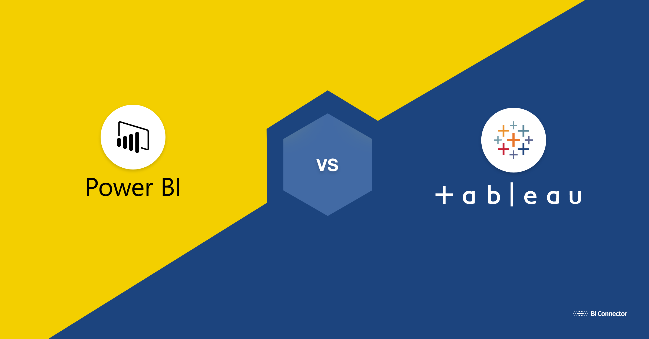


Slide 9


